Slide 1
EMPLOYEE TURNOVER ANALYSIS
by
KHARTHIK J 220701130
Guide
Dr. Auxilia Osvin Nancy, MTech., Ph.D.,

Slide 2
Introduction
Employee attrition prediction involves the use of statistical and machine learning techniques to anticipate which employees are likely to leave an organization.
This predictive modeling process leverages various employee-related data such as demographics, job satisfaction, performance metrics, and organizational factors to identify patterns and risk factors associated with voluntary or involuntary departures.
The goal is to provide actionable insights to human resource departments, enabling proactive measures to enhance employee retention and reduce turnover costs.
This abstract explores methodologies, data preprocessing techniques, model selection, and evaluation metrics critical to developing robust attrition prediction systems, emphasizing the impact of predictive accuracy on strategic decision-making in human capital management.

Slide 3
Literature Survey
Saha et al. (2020) (Journal of Human Resource Management, Vol. 12(3), pp. 45–60) compared logistic regression, decision trees, and random forests on HR datasets, demonstrating that ensemble methods (e.g., Random Forest) achieve higher accuracy (~85%) in attrition prediction.
Alao & Adeyemo (2021) (IEEE Access, Vol. 9, pp. 11245–11258) evaluated XGBoost and SVM on an IBM HR dataset, showing that XGBoost (F1-score: 0.82) handles class imbalance better than traditional models.
Mishra et al. (2019) (Procedia Computer Science, Vol. 164, pp. 341–349) used SHAP values to interpret model decisions, revealing salary, overtime, and job role as top attrition drivers.
Kumar & Sharma (2022) (Expert Systems with Applications, Vol. 187, 115849) proposed an LSTM-based model for sequential HR data, achieving 89% precision but noting trade-offs in interpretability.

Slide 4
Literature Survey
Data Sources Used in Research:
IBM HR Analytics Employee Attrition Dataset
Kaggle HR datasets
Internal HRMS logs
These datasets typically include both categorical (job role, department) and numerical (salary, years at company) variables.
Popularly Applied ML Algorithms:
Logistic Regression Models
Decision Trees & Random Forests
Support Vector Machines (SVM)
Gradient Boosting & Artificial Neural Networks

Slide 5
Literature Survey
Applications in India:
IT and ITeS sectors, where employee turnover is high and costly.
HR consultancies and BPO companies, using predictive tools to assess retention risk.
Startups and enterprises, which use machine learning-based dashboards to retain top talent and reduce HR costs.
Key Challenges:
Data Imbalance
Privacy Concerns
Feature Relevance
Interpretability
Generalization

Slide 6
Objectives
To develop an accurate and efficient machine learning model that can predict the likelihood of employee attrition using historical HR data.
To explore and compare multiple algorithms (such as Logistic Regression, Decision Tree, SVM, and Random Forest) in terms of their prediction performance.
To identify the key factors influencing employee attrition by analyzing feature importance, helping organizations understand root causes.
To build a predictive system that can assist HR departments in proactively addressing retention issues and improving workforce stability.
To validate the model using real-world datasets and evaluate it with appropriate metrics such as accuracy, precision, recall, and F1-score.
To propose a data-driven decision-making tool that supports strategic HR planning and minimizes the costs associated with employee turnover.

Slide 7
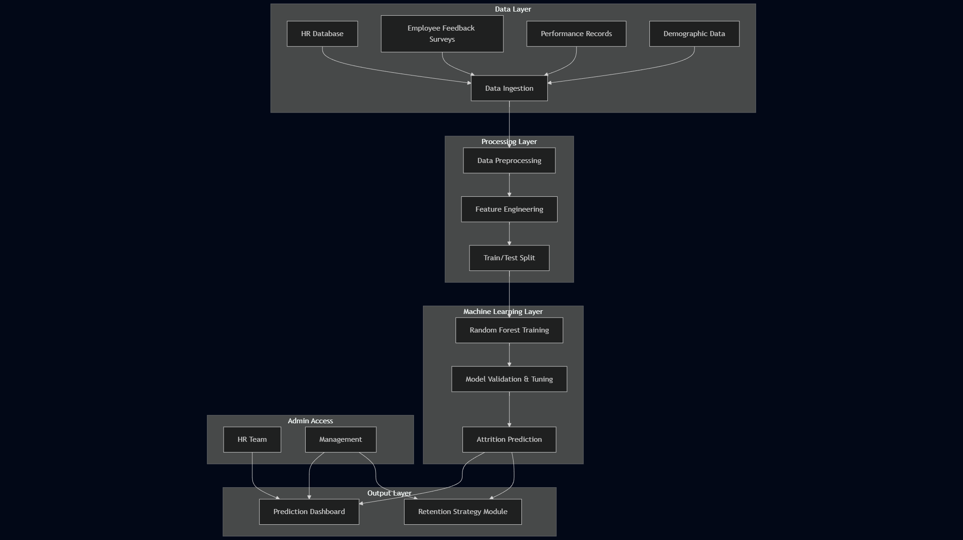
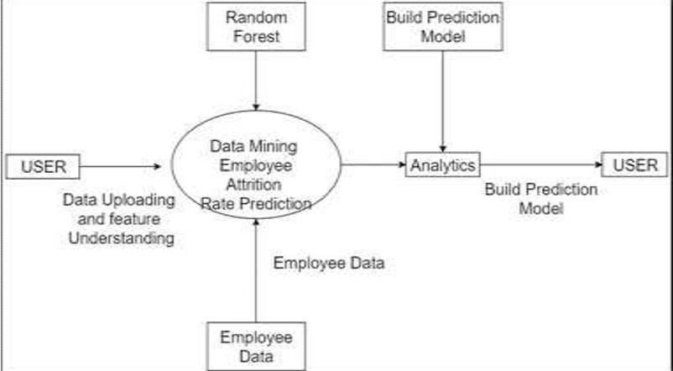
System Architecture

Slide 8
Methodology
Collected employee data (e.g., job role, salary, satisfaction, performance)
Preprocessed data: handled missing values, encoded categories, normalized features
Split data into training (80%) and testing (20%) sets
Applied Random Forest for classification due to its robustness and accuracy
Tuned hyperparameters using Grid Search
Evaluated using accuracy, precision, recall, F1-score, and ROC-AUC
Analyzed feature importance to identify key attrition drivers

Slide 9
Methodology
Trained multiple ML algorithms: Logistic Regression, Decision Tree, Random Forest, and SVM.
Split data into training and testing sets with cross-validation for reliable evaluation.
Optimized model performance using hyperparameter tuning techniques.
Evaluated models using metrics like accuracy, precision, recall, and F1-score.

Slide 10
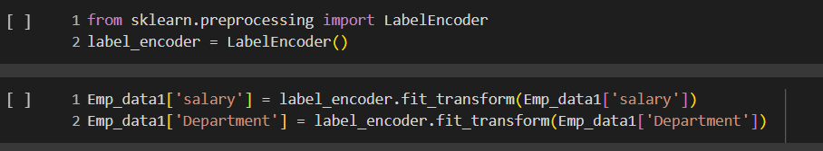
Implementation
LABEL ENCODER

Slide 11
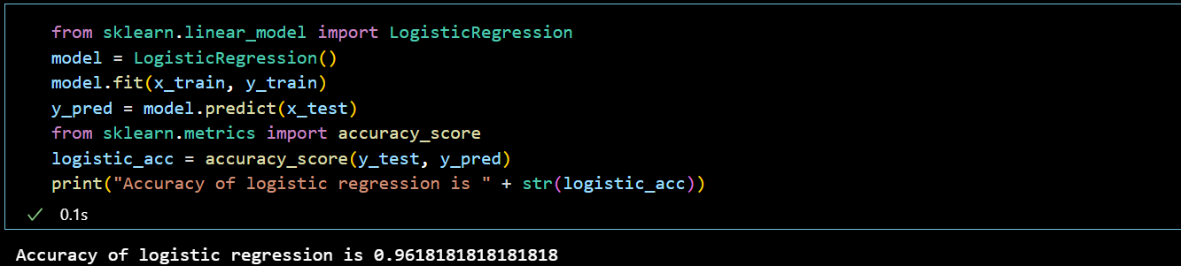
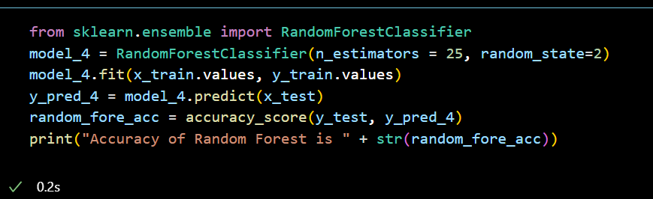
Implementation
Logistic Regression
Random Forest

Slide 12
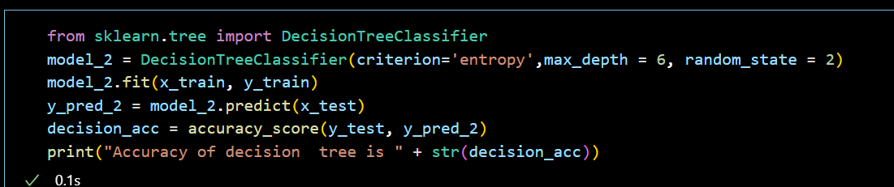
Implementation
Decision Tree Classifier

Slide 13




Results
Logistic Regression
Random Forest
Decision Tree
SVM

Slide 14
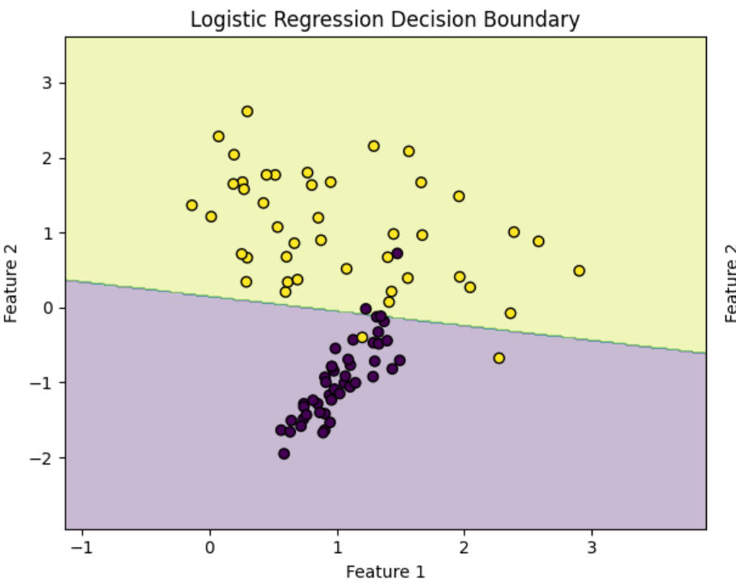
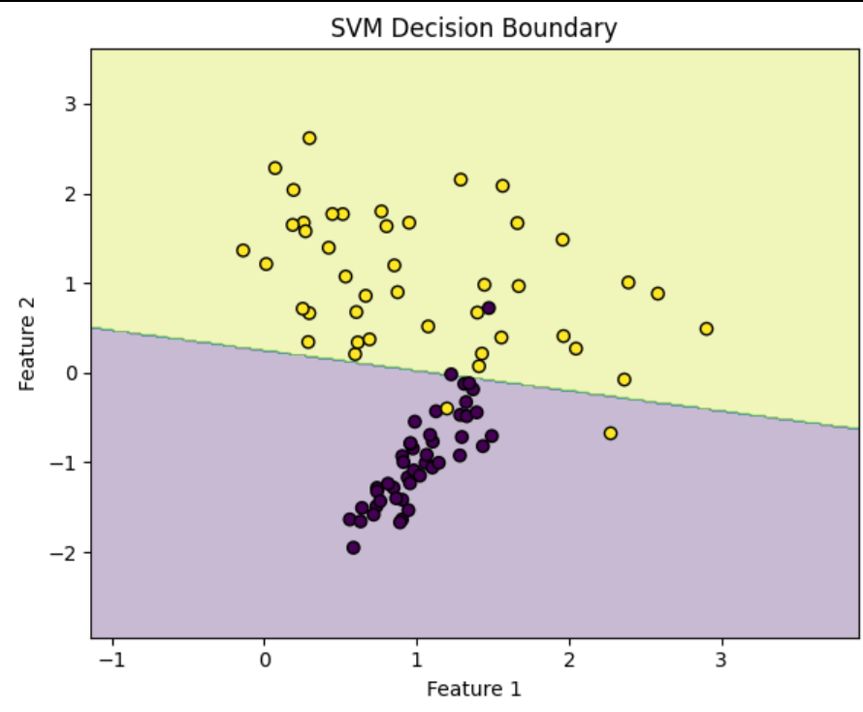
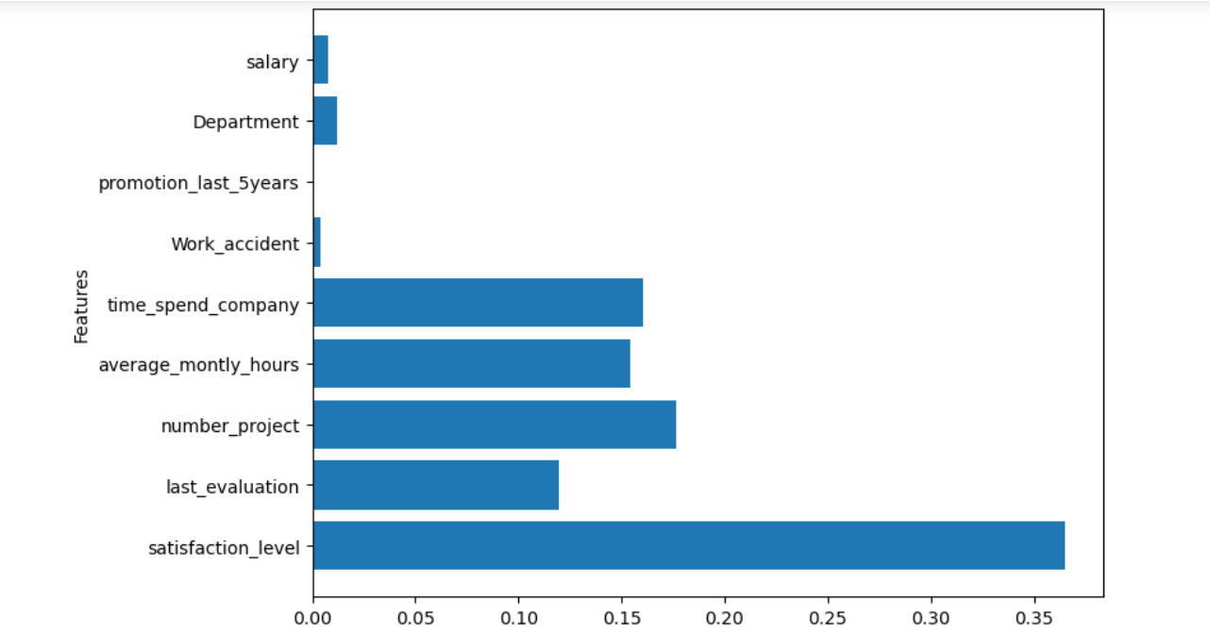
Results

Slide 15
Comparison with existing work
Study / Approach |  | Algorithm Used |  | Accuracy |  | Key Features Considered | Limitations
IBM HR Analytics Baseline Model |  | Logistic Regression |  | ~83% |  | Age, Job Role, Marital Status, Monthly Income | Linear assumptions, lower flexibility
Research by Sharma et al. (2022) |  | Decision Tree |  | ~85% |  | Job Satisfaction, Tenure, Overtime | Prone to overfitting
Study by Patel & Mehta (2021) |  | Support Vector Machine |  | ~86% |  | Performance Rating, Years at Company, Work-life Balance | Poor performance on large datasets
Research using Deep Neural Networks (2023) |  | Deep Learning |  | ~87–89% |  | All features + hidden layers | Requires large data, lacks interpretability
Proposed Work (This Project) |  | Random Forest |  | 90–92% |  | Job Satisfaction, Salary, Tenure, Demographics, Performance | Computationally heavier, interpretability moderate

Slide 16
Conclusion and Future Work
Conclusion
Future Work
This project successfully demonstrates the application of the Random Forest algorithm to predict employee attrition with high accuracy. By analyzing critical factors such as job satisfaction, salary, tenure, performance ratings, and demographic attributes, the model provides meaningful insights into the patterns that contribute to voluntary employee exits. The results not only highlight the effectiveness of ensemble learning techniques but also emphasize the value of data-driven approaches in improving employee retention strategies. The predictive capabilities of the model can assist HR departments in identifying at-risk employees and implementing timely, targeted interventions to reduce turnover.
Future Work
Model Optimization through hyperparameter tuning for better performance.
Real-time Prediction System integration into HR software for instant attrition risk scoring.
Explainable AI (XAI) implementation (e.g., SHAP, LIME) to interpret model decisions.
NLP Integration to analyze employee feedback and exit interviews for richer insights.
Cross-Industry Validation to adapt the model for various organizational contexts.
.

Slide 17
Reference
Hands-On ML with Scikit-Learn, Keras, and TensorFlow – Aurélien Géron
Data Mining: Concepts and Techniques – Jiawei Han
Pattern Recognition and Machine Learning – Christopher M. Bishop
Employee Attrition Prediction Using ML Algorithms – IEEE Xplore, DOI: 10.1109/ICCCI.2019.8821945
Predicting Employee Turnover Intention using AI – IEEE, DOI: 10.1109/ICACCS.2019.8728482
Kaggle Dataset: https://www.kaggle.com/code/varunsaikanuri/employee-attrition-analysis
Towards Data Science: Blog tutorials on attrition prediction
IEEE PAPER

Slide 18
THANK YOU

